Slide 1
Water
Learning story by Victoria Year 6
Epping Views Primary School

Slide 2
Water Sustainability at EVPS
What our school has to do with water.
Water tanks
Reusing water
Collecting rainwater
Regular water analysis in classes
Water to me is a sacred resource that we need to preserve and take care of while we have it, it’s in our daily lives, washing hands, taking showers, drinking, growing our produce. At EVPS we do a fabulous job at saving and reusing it, we have some drains that lead to our water tanks that we use to water our plant and our regular gardening, not for drinking.

Slide 3
My Journey as a Water Leader
In my journey as a water leader I have learnt that clean water and even water in general is an exceptionally important resource that we need to preserve for future use and generations, it’s a basic necessity that keeps us alive, from drinking it to it watering our crops, even having a shower, all these things only because water is a thing and I find that we need to be educated on how important these things are.
Our water supply is slowly decreasing with each passing day, from us just using it to drink, wash our veggies and showering, or us wasting water for our entertainment, and polluting our rivers and creeks. This all has an impact on our future for water and how much of it we have left.
Some of us don't appreciate enough water and don't understand how lucky we are to have access to it when there are other places in the world where even getting a sip of water is a gift.
I hope that the school continues to have leaders that are sustainable and have the passion to continue to make small steps and educate others to help make the area we live in more and more sustainable.

Slide 4
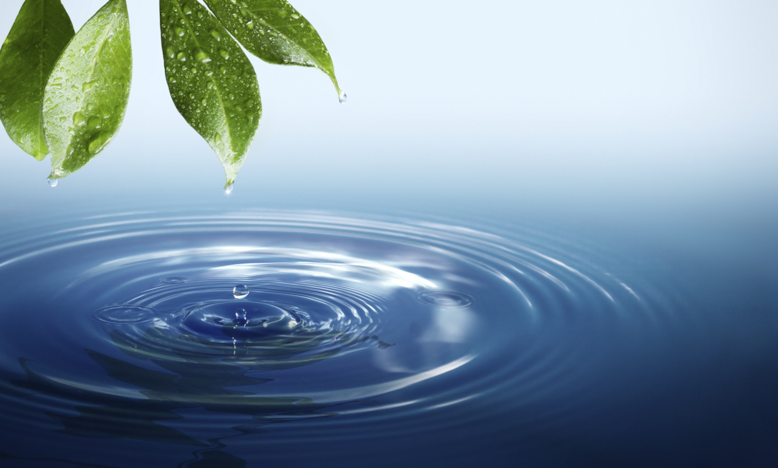
My hope for EVPS in Water Sustainability
I hope the school continues to be sustainable holds up our reputation with being sustainable.

